Slide 1
Category review: Chips
Retail Analytics
Brand note: If client logo is not required, use alternate title page layout right click slide thumbnail > Layout > Title

Slide 2
Notes:
To view Privacy video explaining how important data privacy is to Quantium, please click here: https://www.youtube.com/watch?v=Zq1QDAkoRzU
or here Q:\Company Reference\Brand & Design\Brand videos\Q Privacy.mp4
At Quantium, we believe that data is the behavioural footprint of humanity and that it has to be treated with the utmost care and responsibility.
Histories, attitudes, indeed lives are stored within it in ways that aren’t always apparent – and that’s what makes its potential so powerful.
To work with it responsibly, sensitively, we set ourselves the highest data privacy protection and governance standards.
We have spent 17 years perfecting privacy-by-design and secure-by-design principles. Central to this is not holding any personally identifiable information about people –
we neither receive it, and put the necessary protections in place to be unable to decipher it.
Every aspect of handling data is safeguarded: from its de-identification, to its encryption – data security is paramount and of the highest grade.
We pride ourselves on gaining the trust of iconic organisations around the world through years of securely working with their data,
and in turn the trust that builds with their stakeholders.

Slide 3
Executive summary
Customer behavior analysis shows clear differences across life-stage and affluence segments.
“Older Families” and “Young Families” purchase chips more frequently and spend significantly more per trip than other life-stages.
“Mainstream” and “Budget” customers account for the highest overall volume, while “Premium” customers contribute disproportionately to revenue due to higher spend per unit.
These patterns highlight strong opportunities to target high-value segments through tailored promotions and pack-size strategies.
01
Task 1
02
A control store with highly similar customer and sales characteristics to the trial store was successfully identified.
During the trial period, the trial store outperformed its control store across key metrics, including total sales, customer count, and average spend.
The uplift observed in the trial store indicates that the implemented strategy had a positive commercial impact.
Results support scaling the trial initiative across additional stores with similar customer profiles.
Task 2

Slide 4

01
Category

Slide 5
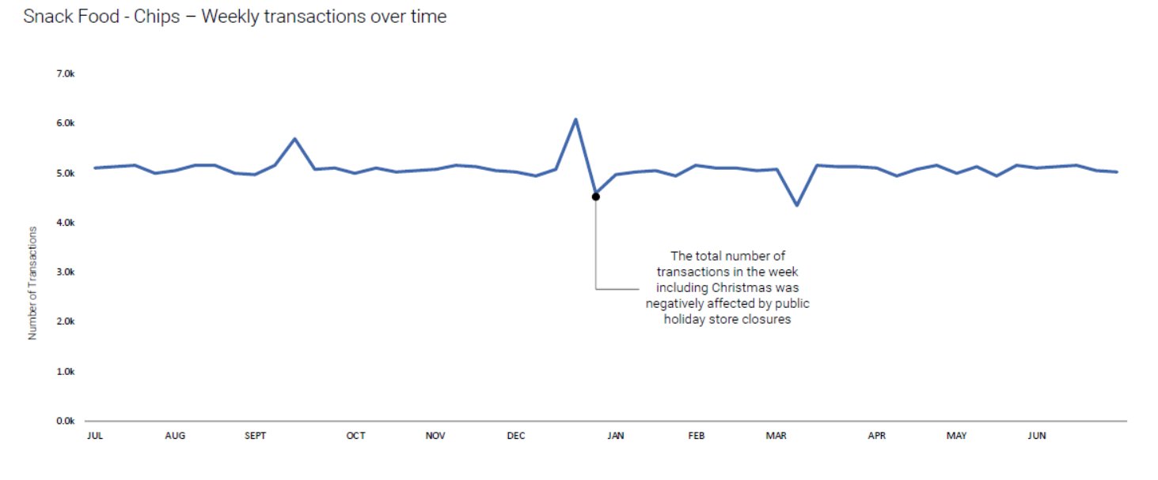
Overall chips transactions remain stable throughout the year, with a sharp dip during the Christmas week due to public holiday store closures, followed by a quick return to normal trading levels.

Slide 6
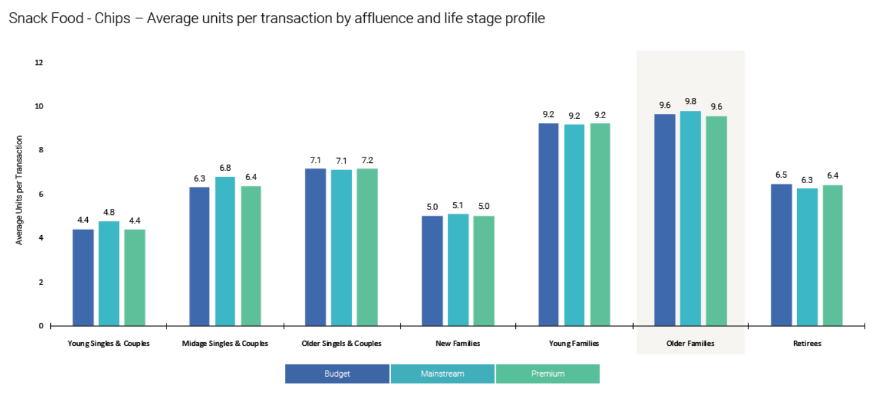
Life stage is the key driver of chips purchasing, with Older Families and Young Families buying the highest units per transaction. Affluence has only a minor impact, as Budget, Mainstream, and Premium shoppers behave similarly within each segment. Overall, family segments present the strongest opportunity due to consistently larger basket sizes.

Slide 7
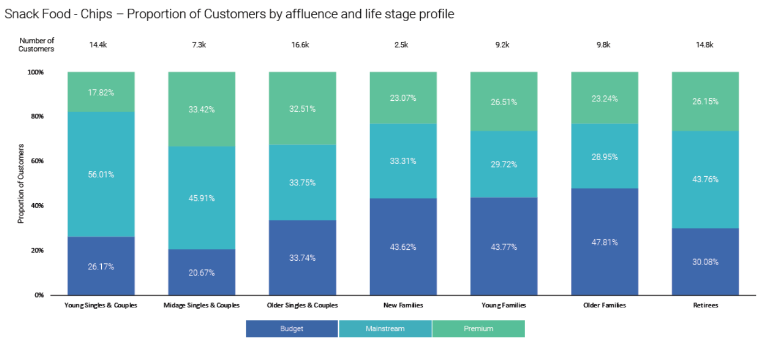
Mainstream customers make up the largest share of shoppers across nearly all life-stage groups, especially among Young Singles & Couples and Retirees. Premium customers are more concentrated within Singles & Couples segments, while Budget shoppers are more prominent in family segments. Overall, customer mix varies more by life stage than by affluence, reinforcing life stage as the primary lens for category targeting.

Slide 8

02
Trial store performance

Slide 9
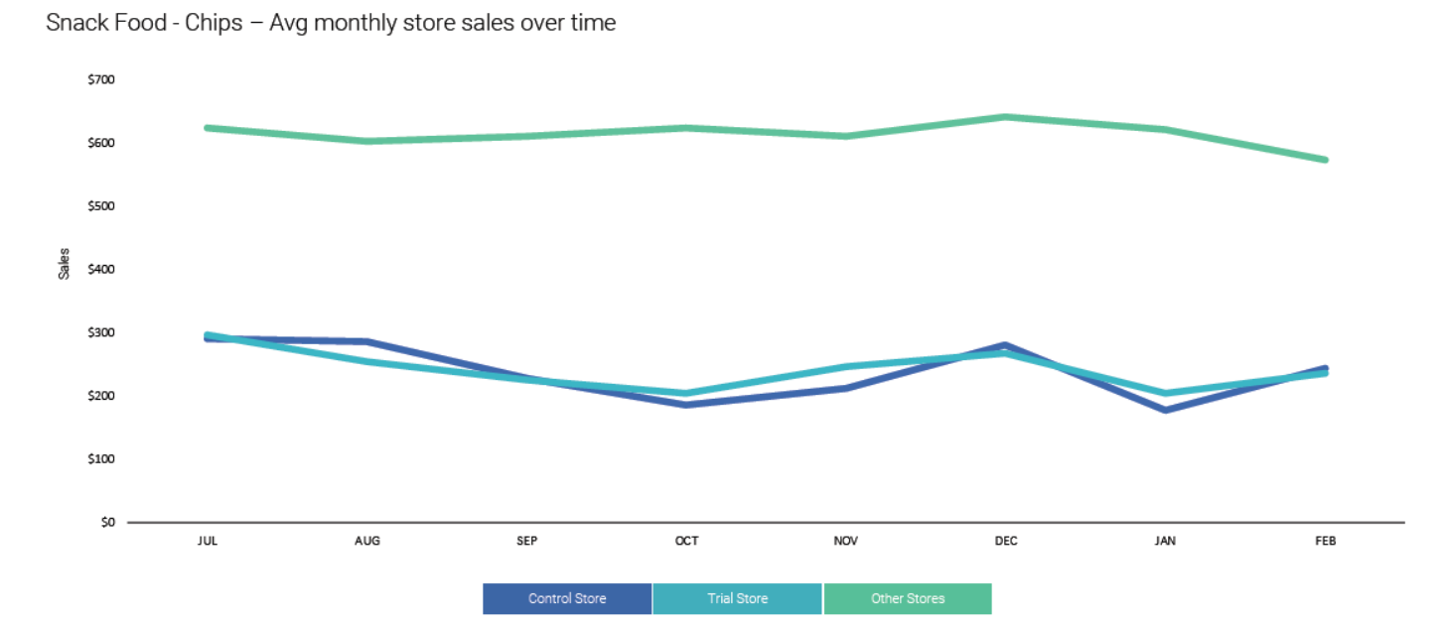
The selected control store closely mirrors the trial store’s sales patterns over time, confirming it as a valid benchmark for comparison. Both the trial and control stores follow the same seasonal trends, with a dip around October–January similar to the broader store network. This alignment ensures that any uplift observed during the trial can be confidently attributed to the trial intervention rather than external market factors.

Slide 10
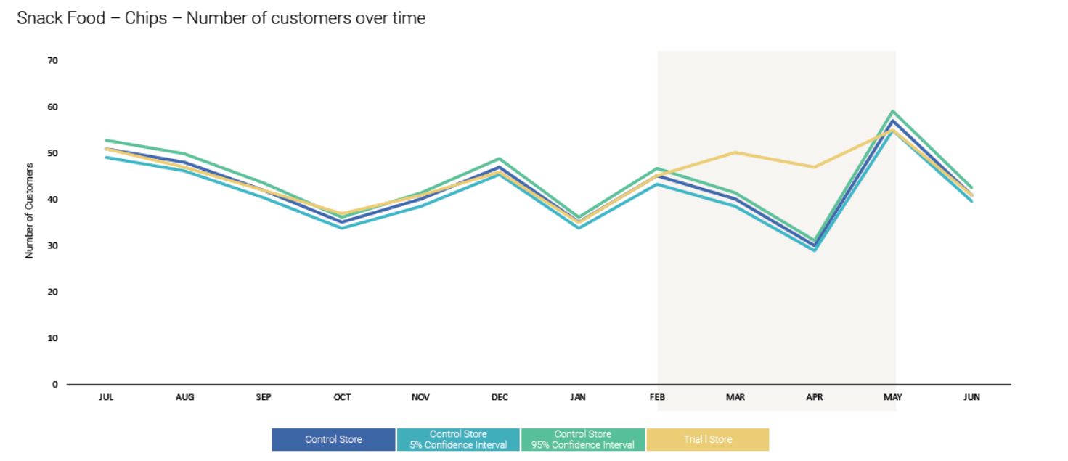
During the trial period (Feb–May), the trial store’s customer numbers rose noticeably above the control store and its confidence intervals. This uplift is consistent and sustained across the entire trial window, peaking sharply in May. The clear separation from the control trend indicates that the trial intervention successfully increased customer traffic.

